Slide 1
Object-Oriented and
Classical Software Engineering
8th Edition, WCB/McGraw-Hill, 2010
Stephen R. Schach srs@vuse.vanderbilt.edu

Slide 2
CHAPTER 1
THE SCOPE OF SOFTWARE ENGINEERING

Slide 3
Outline
Historical aspects
Economic aspects
Maintenance aspects
Requirements, analysis, and design aspects
Team development aspects
Why there is no planning phase
Why there is no testing phase
Why there is no documentation phase

Slide 4
1.1 Historical Aspects
1968 NATO Conference, Garmisch, Germany
Aim: To solve the software crisis
Software is delivered
  Late
  Over budget
  With residual faults

Slide 5
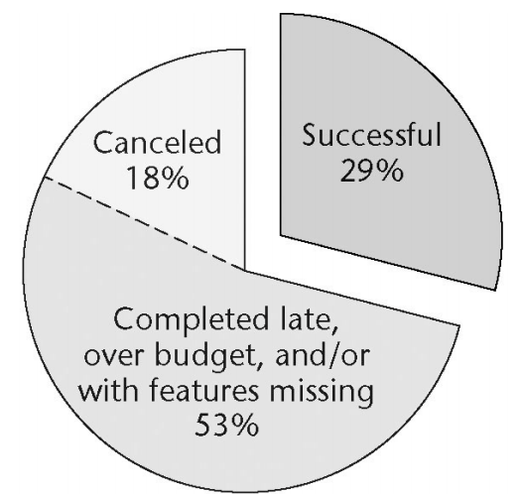
Standish Group Data
Data on
9236
projects
completed
in 2004

Slide 6
Cutter Consortium Data
2002 survey of information technology organizations
  78% have been involved in disputes ending in litigation
For the organizations that entered into litigation:
  In 67% of the disputes, the functionality of the information system as delivered did not meet up to the claims of the developers
  In 56% of the disputes, the promised delivery date slipped several times
  In 45% of the disputes, the defects were so severe that the information system was unusable

Slide 7
Conclusion
The software crisis has not been solved
Perhaps it should be called the software depression
  Long duration
  Poor prognosis

Slide 8
1.2 Economic Aspects
Coding method CM_{new} is 10% faster than currently used method CM_{old}. Should it be used?
Common sense answer
  Of course!
Software Engineering answer
  Consider the cost of training
  Consider the impact of introducing a new technology
  Consider the effect of CM_{new} on maintenance

Slide 9
1.3 Maintenance Aspects
Life-cycle model
  The steps (phases) to follow when building software
  A theoretical description of what should be done
Life cycle
  The actual steps performed on a specific product

Slide 10
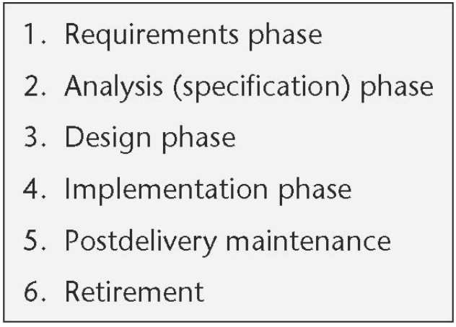
Waterfall Life-Cycle Model
Classical model (1970)

Slide 11
Typical Classical Phases (contd)
Postdelivery maintenance
  Corrective maintenance
  Perfective maintenance
  Adaptive maintenance

Slide 12
1.3.2 The Importance of Postdelivery Maintenance
Bad software is discarded
Good software is maintained, for 10, 20 years or more
Software is a model of reality, which is constantly changing

Slide 13
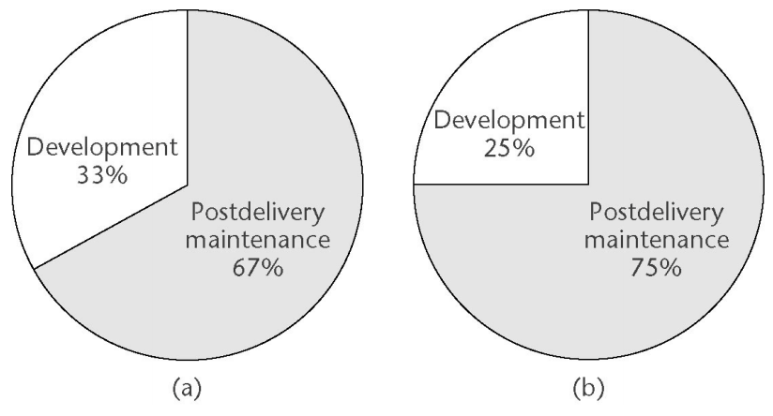
Time (= Cost) of Postdelivery Maintenance
(a) Between 1976 and 1981
(b) Between 1992 and 1998

Slide 14
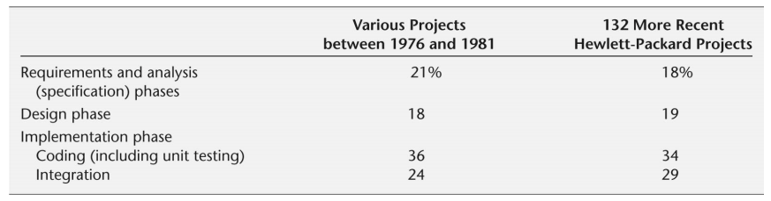
The Costs of the Classical Phases
Surprisingly, the costs of the classical phases have hardly changed

Slide 15
Consequence of Relative Costs of Phases
Reducing the coding cost by 10% yields at most a 0.85% reduction in total costs
  Consider the expenses and disruption incurred
Reducing postdelivery maintenance cost by 10% yields a 7.5% reduction in overall costs

Slide 16
1.4 Requirements, Analysis, and Design Aspects
The earlier we detect and correct a fault, the less it costs us

Slide 17
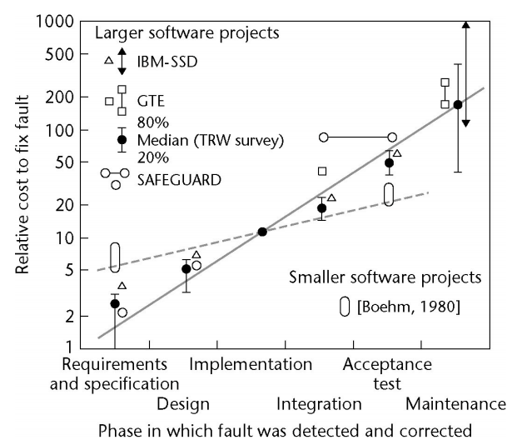
Requirements, Analysis, and Design Aspects (contd)
The cost of
detecting and
correcting a
fault at each
phase

Slide 18
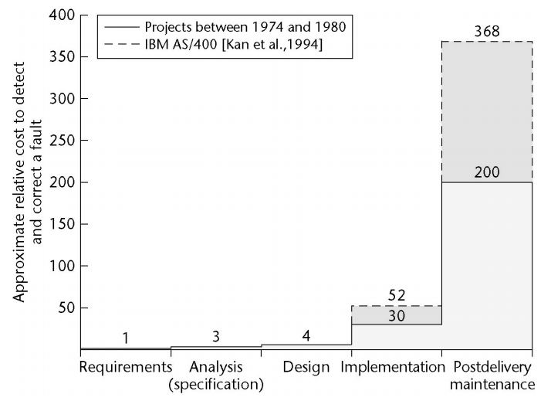
Requirements, Analysis, and Design Aspects (contd)
The
previous
figure
redrawn
on a
linear
scale

Slide 19
Requirements, Analysis, and Design Aspects (contd)
To correct a fault early in the life cycle
  Usually just a document needs to be changed
To correct a fault late in the life cycle
  Change the code and the documentation
  Test the change itself
  Perform regression testing
  Reinstall the product on the client’s computer(s)

Slide 20
Requirements, Analysis, and Design Aspects (contd)
Between 60 and 70% of all faults in large-scale products are requirements, analysis, and design faults
Example: Jet Propulsion Laboratory inspections
  1.9 faults per page of specifications
  0.9 per page of design
  0.3 per page of code

Slide 21
Conclusion
It is vital to improve our requirements, analysis, and design techniques
  To find faults as early as possible
  To reduce the overall number of faults (and, hence, the overall cost)

Slide 22
1.5 Team Programming Aspects
Hardware is cheap
  We can build products that are too large to be written byone person in the available time
Software is built by teams
  Interfacing problems between modules
  Communication problems among team members

Slide 23
1.6 Why There Is No Planning Phase
We cannot plan at the beginning of the project
— we do not yet know exactly what is to be built

Slide 24
Planning Activities of the Classical Paradigm
Preliminary planning of the requirements and analysis phases at the start of the project
The software project management plan is drawn up when the specifications have been signed off by the client
Management needs to monitor the SPMP throughout the rest of the project

Slide 25
Conclusion
Planning activities are carried out throughout the life cycle
There is no separate planning phase

Slide 26
1.7 Why There Is No Testing Phase
It is far too late to test after development and before delivery

Slide 27
Testing Activities of the Classical Paradigm
Verification
  Testing at the end of each phase (too late)
Validation
  Testing at the end of the project (far too late)

Slide 28
Conclusion
Continual testing activities must be carried out throughout the life cycle
This testing is the responsibility of
  Every software professional, and
  The software quality assurance group
There is no separate testing phase

Slide 29
1.8 Why There Is No Documentation Phase
It is far too late to document after development and before delivery

Slide 30
Documentation Must Always be Current
Key individuals may leave before the documentation is complete
We cannot perform a phase without having the documentation of the previous phase
We cannot test without documentation
We cannot maintain without documentation

Slide 31
Conclusion
Documentation activities must be performed in parallel with all other development and maintenance activities
There is no separate documentation phase

